Slide 1
SDK Scope
Satish Patel
4/28/2007

Slide 2
UML Model Support
UML Model Support
  Abstract class
  Marker interfaces
O/R Mapping
  Implicit inheritance support

Slide 3
Defect Fixes
[#4150] WS does not handle inheritance properly
[#4153] WS does not support comma separated nested search paths
[#8951] GetHTML query syntax does not support slashes in the criteria
[#9282] Association to a class in a different package does not work in XSD
[#9392] Uppercase association names generate error in WS
[#9602] Validation error in testing association to a class in a different package
[#9618] The SDK Test Model KEY table causes an SQLException in MySQL
[#10639] Associations in related packages are not checked
[#11189] Search Object drop down is not populated with the correct classnames
[#11191] Generation of inefficient subqueries results in slow performance and timeouts
[#11866] ApplicationService methods do not allow casting of results
[#12454] camel case error
[#12539] inheritance across package results in incorrect hibernate mapping
[#12636] Eager loaded objects are not proxied correctly
[#13110] associations to the child class in the table per hierarchy with leaf in separate table not being validated
[#13111] Super class in separate package generates incorrect HBM files
[#13133] Missing id attribute error in Castor mapping file generation
[#13144] WS getTotalNumberOfRecords returns incorrect number
[#13295] isJoinedSubclass() test in NestedCriteria2HQL is causing query criteria to be ignored
[#13365] Implicit polymorphism: Associations from root class are attributed to subclasses
[#13481] Unmarshalling test for remote client throws exception
[#13577] Interfaces (in a different package) displaced with realization classes in the same package on the web interface

Slide 4
Writable API
Enhanced hibernate mapping files
  Primary Key generator
  Cascade settings
  Eager load settings
  inverse-of settings
  Not-null settings
Full array of CRUD operations
Batch operations
Validation of data to be written
Security implementation

Slide 5
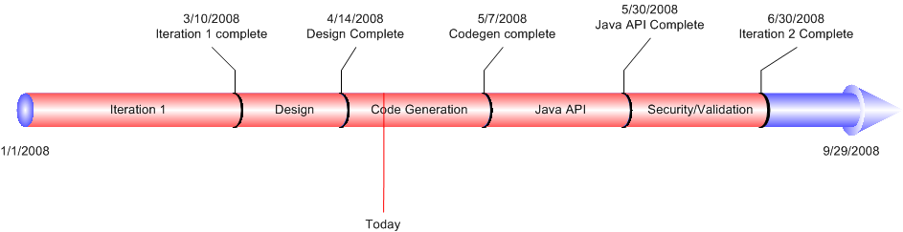
Timeline

